Slide 1
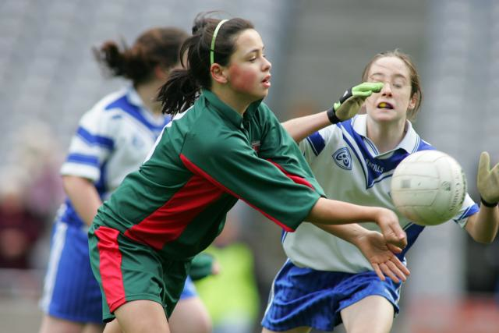
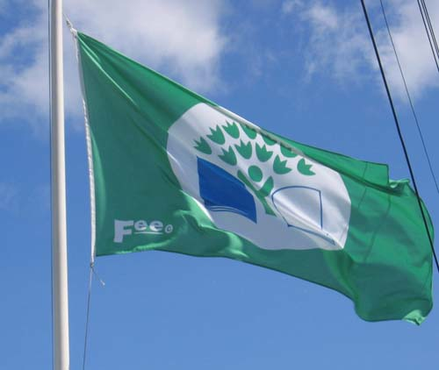
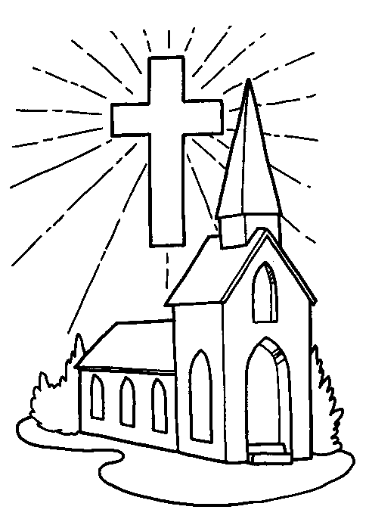
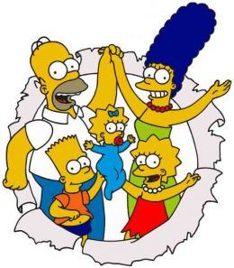
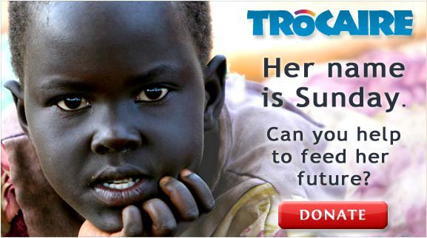
The Parish Community
Can you tell me what each of these pictures represent in your community?

Slide 2
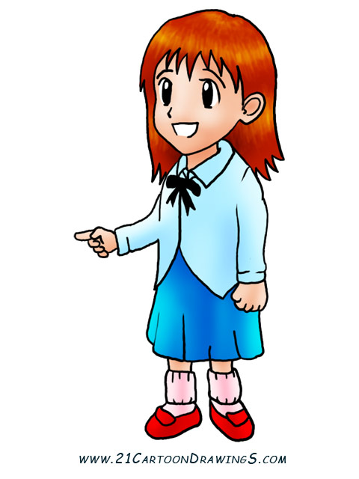
What do you think of when you hear the word ‘Community’?
We can say that a community is a group of people who share something in common, for example, where we live, a hobby or our religious beliefs!

Slide 3
Here is a the flower I drew it shows you all the different communities I belong to!
Church
Family
ME
Medical
Sports
School
Local

Slide 4
Every Sunday my family all go to celebrate mass together. This is a place where all the community can come together to celebrate our faith!

Slide 5
At Mass the Priest sometimes talks about other communities all over the world. Did you know there are some children who don’t get to go to school in the world? They are so poor and they need our help!
Can you think of ways that your community helps other poorer communities in the world?

Slide 6
At Lent in our church and in school we all collect money for Trocaire! The money we collect helps children all over the world have a better life like me and you!

Slide 7
Trocaire in Irish means ‘compassion’
Trocaire helps people all over the world who suffer from poverty.
It works in communities all over the world like Peru, India and Kenya.
They help people grow their own food, go to school and look after their families.
At lent we can help these communities by donating money to Trocaire in our Trocaire boxes.

Slide 8
.

