Slide 1
Christian Denominations

Slide 3
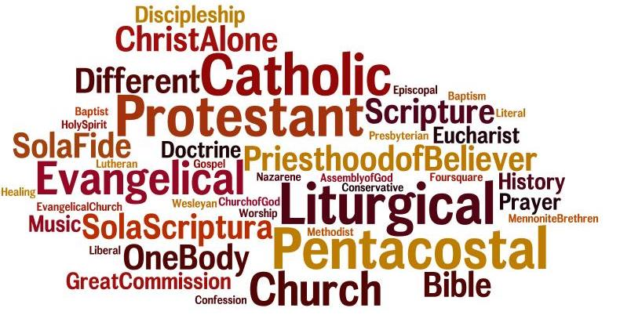
Let’s take a look...

Slide 4
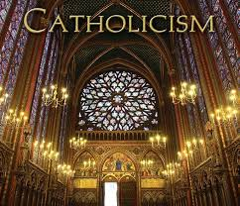
Roman Catholic Church
Head of Church: The Pope
Vatican, Rome, Italy

Slide 5
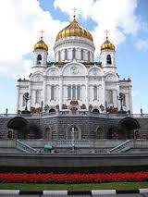
2. Orthodox Church
Head of Church: The Patriarch
Eastern Europe: Constantinople

Slide 6
Protestant Churches
Protestant is a general term for a group of Christian denominations who separated from the Roman Catholic Church. There are a few Protestant Churches….

Slide 7
Church of England (Anglican)
Leader of Church: Archbishop of Canterbury.
Governed by the Royal Crown.
Founded in England

Slide 8
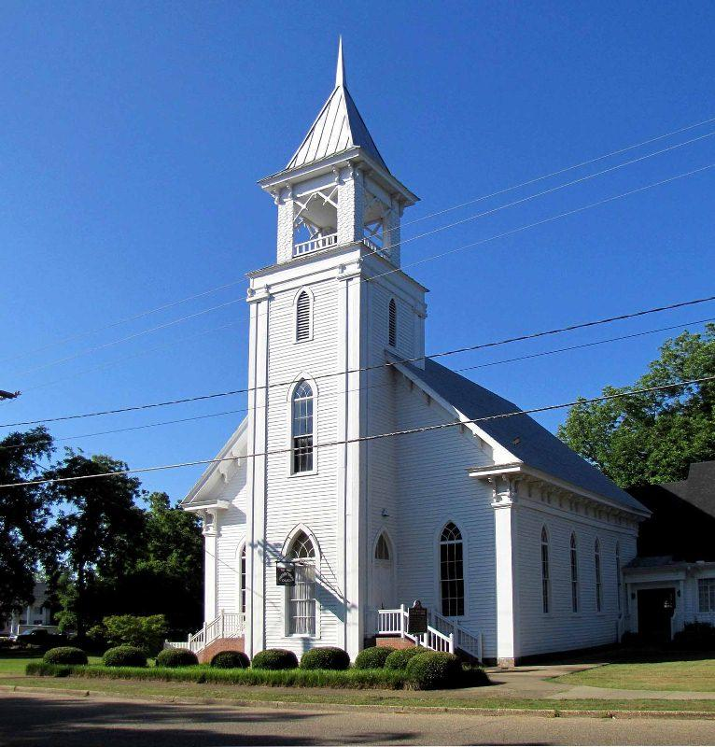
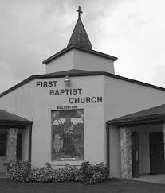
2. Presbyterian Church
Founder: John Knox (influenced by John Calvin)
Founded in Scotland

Slide 9
3. Baptist Church
Founded by Thomas Helwys
Founded in London

Slide 10
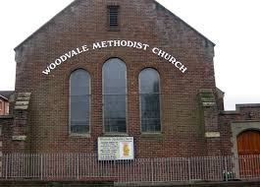
4. Methodist Church
Founded by John Wesley
Founded in England

