Slide 1
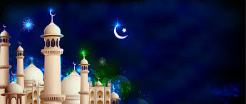
Festival
Eid al-Fitr

Slide 2
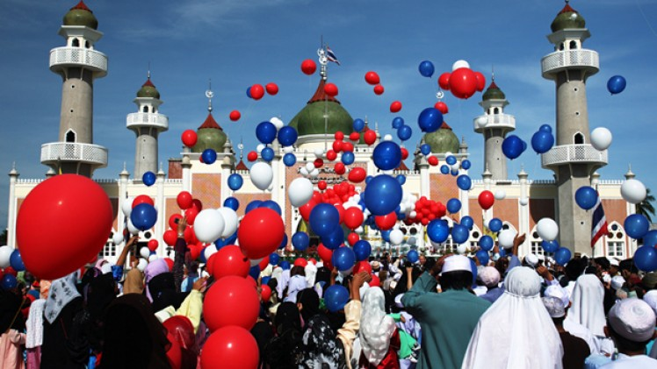
Eid al-Fitr
Eid al-fitr is one of two festivals in Islam

Slide 3
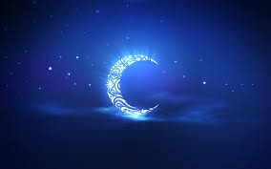
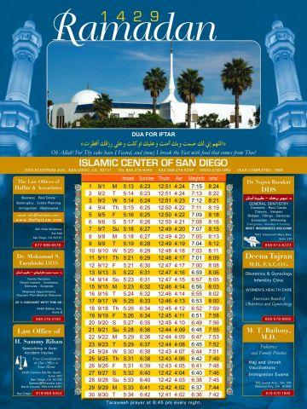
Eid al-Fitr celebrates the end of the month of Ramadan.
It begins on the first day of the next month (Shawal). This festival last for 3 days.

Slide 4
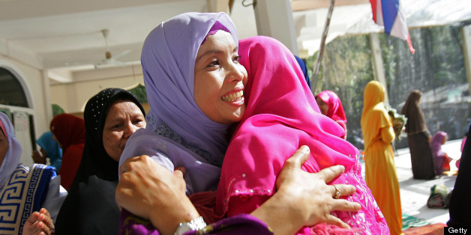
It is an occasion to thank Allah for supporting Muslims during Ramadan (the fasting month).
It is a joyful festival celebrated by all.

Slide 5
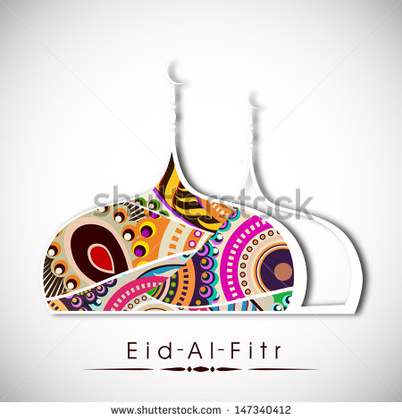
In the morning families attend the Mosque for prayer. Everyone attends wearing their best clothes.

Slide 6
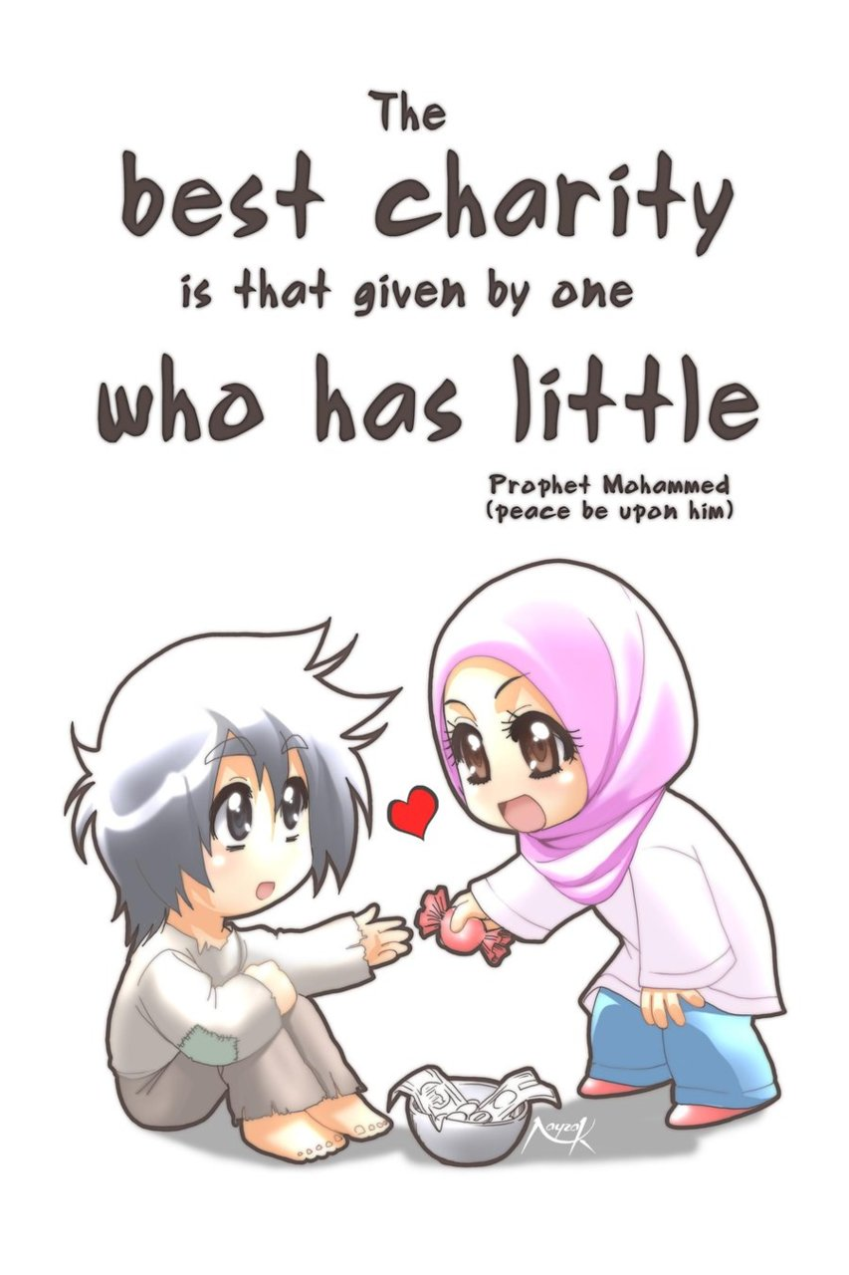
Donations collected during Ramadan are given to the poor so that they can join in the celebration.

Slide 7
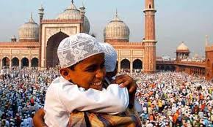
Families and friends visit each others’ homes. Children are given gifts and sweets.

