Slide 1
Hajj
Pilgrimage to Mecca the Holy City
The 5th Pillar of Islam

Slide 2
What is a Pilgrimage?
A special journey to a special holy place.
The Hajj is a pilgrimage that Muslims make.
They make the trip once in their lifetime as it is one of the five pillars.
They follow the first pilgrimage made by Prophet Abraham 4000 years ago and later by Prophet Muhammad.
The pilgrimage is a journey to God.

Slide 4
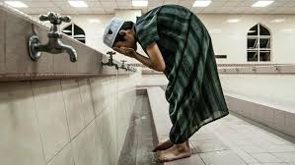
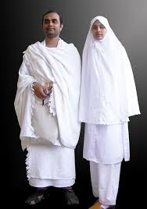
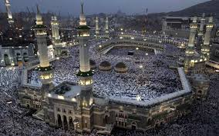
Arrival in Saudi Arabia
Pilgrims arrive just outside the city of Mecca.
Here they ritually wash themselves and put on white clothing.
Every pilgrim must wear white clothing, this shows that everyone is equal before Allah.
This clothing is called an Ihram.

Slide 5
The Ka’ba
In Mecca pilgrims go to the Ka’ba.
They walk around the Ka’ba 7
times.
The Ka’ba is a cube shaped
building within the courtyard
of the great Mosque in Mecca.

Slide 6
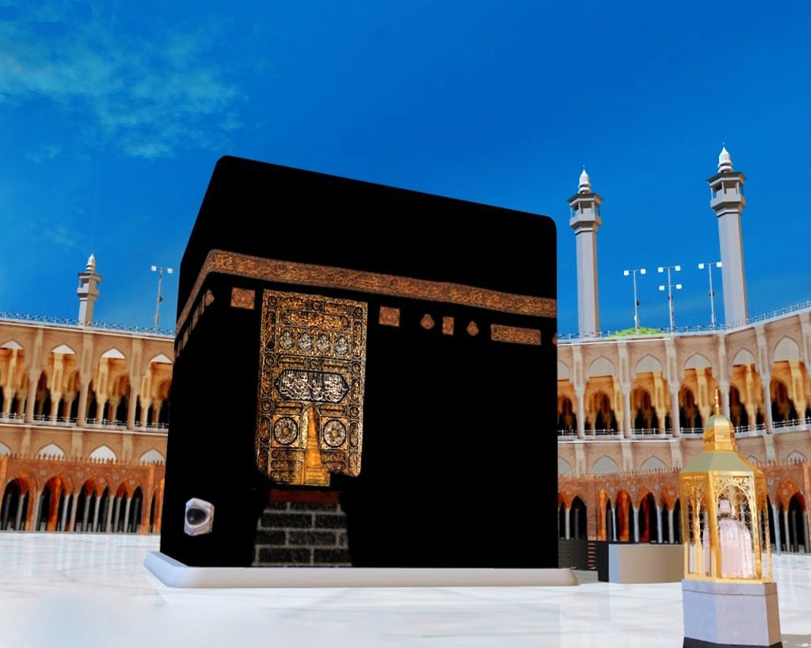
A ‘black stone’ that Muslims believe came from heaven is kept inside the Ka’ba.
A dark cloth covers the shrine all over with words from the Qu’ran written on it.
Muslims believe the Ka’ba was first built by the Prophet Abraham and his son Ishmael over 4000 year ago.
It was later restored by Muhammad as a place of worship to Allah.

Slide 7
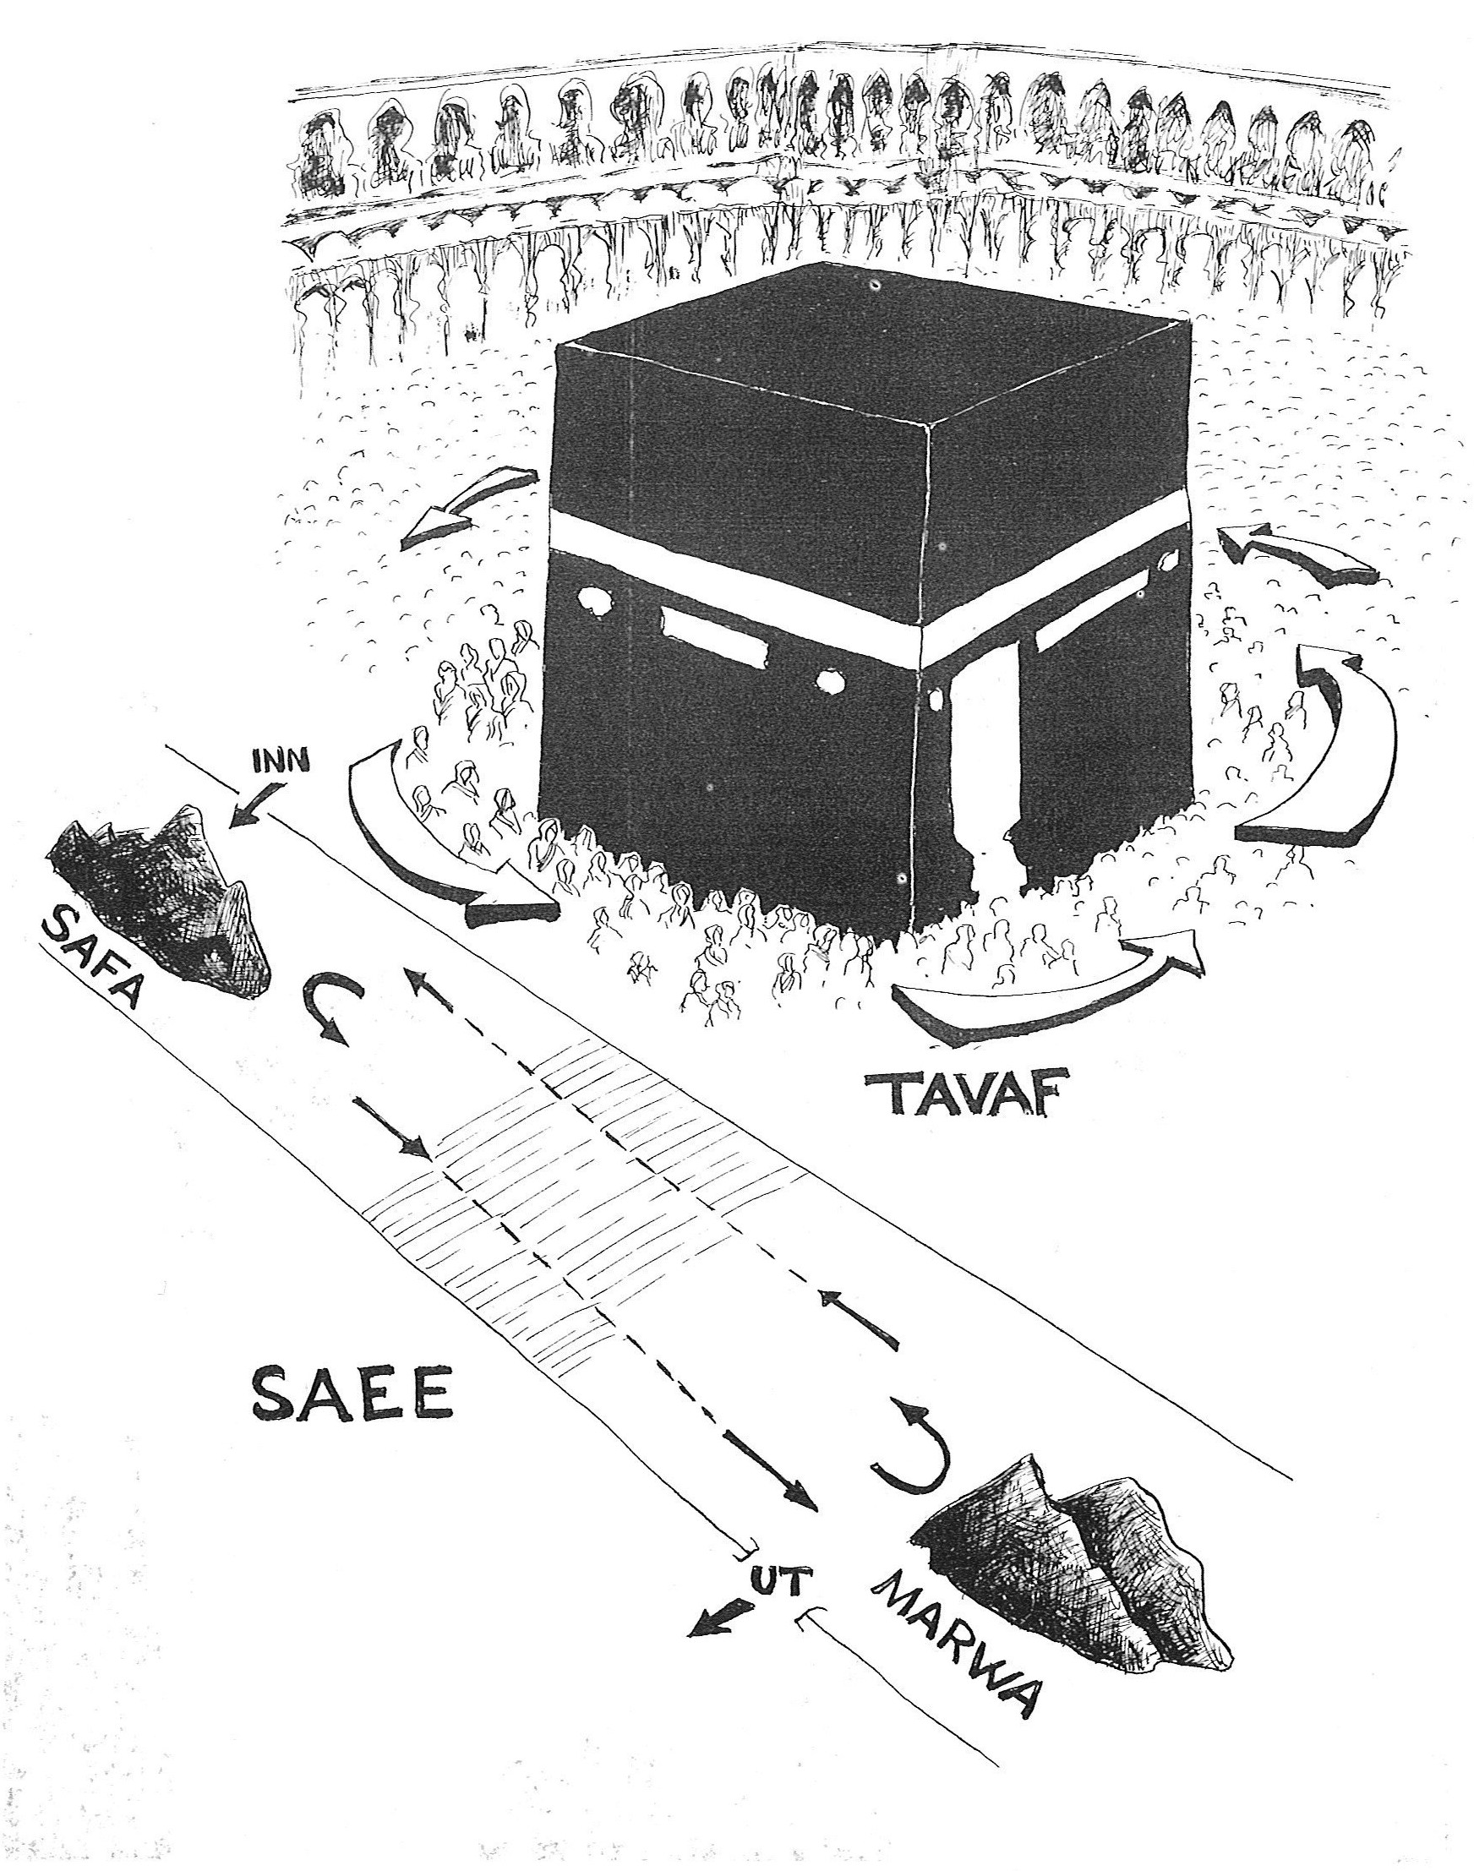
Hills of Safa and Marwa
Pilgrims then hurry between two smalls hills close to the Ka’ba.
They are connected by a long corridor.
The pilgrims believe that God told Abraham to leave his wife Agar and Ishmael alone in the desert.
When their water supply ran out Hagar ran between the two hills praying and searching for water.
Her prayers were answered when Ishmael found a well.

Slide 8
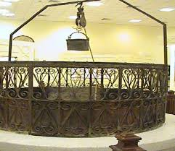
The well Ismael found is called the Zamzam.
Pilgrims take water from the Zamzam.
It is also located close to the Ka’ba.

Slide 9
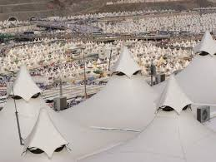
Mina
The Pilgrims travel to Mina twice throughout the pilgrimage.
The first time they visit Mina:
Pilgrims camp in tents in Mina for one night. They leave after dawn prayer.

Slide 10
Plain of Arafat
Pilgrims then travel to the Plains of Arafat where
they stand in the desert for the day and pray to God.
Here they focus on becoming closer to God and
promising to become good moral muslims.
They also ask God for his forgiveness.
They hope after praying to Allah they will have
the strength to be better people.

Slide 11
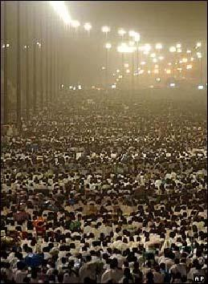
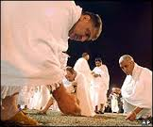
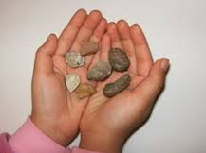
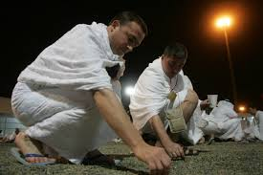
Muzdalifa
Pilgrims end their day of prayer and contemplation in Muzdalifa.
Here they collect small pebbles.
They then travel back to Mina.

Slide 12
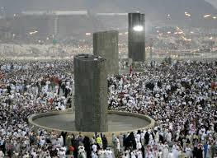
Back to Mina
They use these small pebbles to throw at Pillars in Mina.
By throwing these pebbles muslims believe they are casting out the devil.
This they believe will help them lead better lives.
They also sacrifice an Animal and the men shave their heads here.

Slide 13
Last Stop….Mecca!
Pilgrims return to Mecca and circle the Ka’ba 7 times.
Once the pilgrims have completed all the rituals they are
given a new title. A man is now a ‘Hajji’ and a woman a ‘Hajja’.

