Slide 1
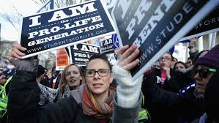
Respect for Life
A Christian Perspective on Abortion

Slide 2
Key Words
Respect: to have a high regard for someone or something, and to treat each other with great care.
Life: the state or quality of being alive.

Slide 3
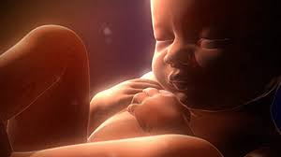
Human life is precious, it should be treated with care and respect.

Slide 4
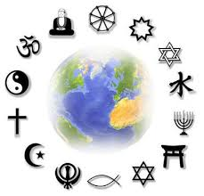
Major World Religions
The major world religions teach that all life is sacred and holy. We are special.
This specialness needs to be protected and respected.

Slide 5
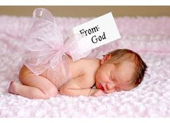
Christianity and Judaism for example believe:
Human life is a gift from God.
Human life needs to be treated with care and respect.

Slide 6
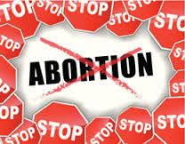
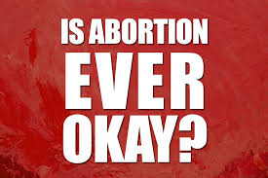
The Christian Churches
Other Christians believe abortion is wrong but that it could be allowed under certain circumstances.
Some Christians believe Abortion is murder and it is always wrong.

Slide 7
According to some Christians abortion is okay when….
There is a case of Rape.
The mother’s life is at risk.
The baby is severely disabled.
The baby no longer has a heartbeat.

Slide 8
The Catholic Moral vision
The Roman Catholic Church is against abortion.
It teaches that abortion is morally wrong.
They base their beliefs on the Bible.

Slide 9
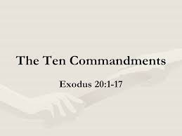
God created life; only God can take it away. Taking of any innocent life is murder. It breaks the commandment of God. (Exodus 20:13)

Slide 10
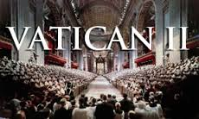
Human life begins at conception. From the moment the egg is fertilized a new life begins and must be protected.

Slide 11
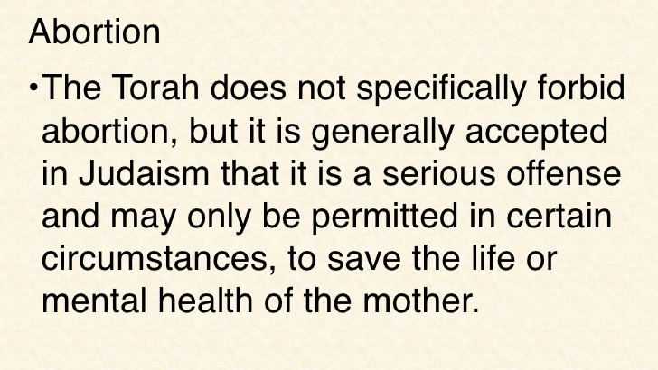
The Jewish View

Slide 12
Question Time
What is the meaning of respect?
What religious belief influences both Christians and Jews to have a deep respect for life?
What is the Roman Catholic position on abortion?
What religious teaching would a Catholic use to support their view that abortion is morally wrong?
What religious teaching would a Jew use to support their view that abortion is morally wrong, but may be allowed in some circumstances?

