Slide 1
SECTARIANISM
Hatred of people because they belong to a different religious group.

Slide 2
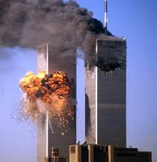
On September 11th 2001 two planes crashed into the Twin Towers in New York City.

Slide 3
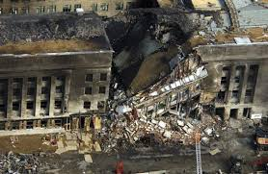
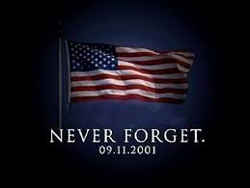
A plane also crashed into the Pentagon in Washington.

Slide 4
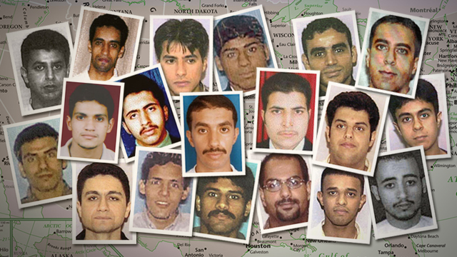
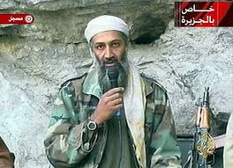
These horrible attacks were planned and carried out by a terrorist group called Al-Queda led by a man called Osama bin Laden .

Slide 5
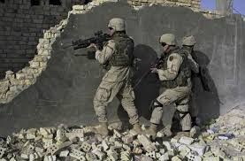
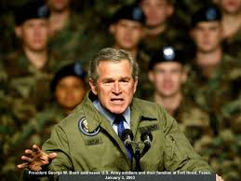
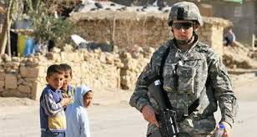
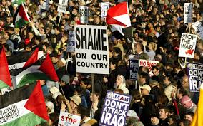
After these attacks the American Government declared war in Iraq. The country where they believed this terrorist group were from.

Slide 6
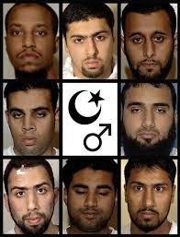
Iraq is a country where Muslim people live. These terrorists said they killed thousands of American people in the name of Allah (God). They said they were Islamic Terrorists.

Slide 7
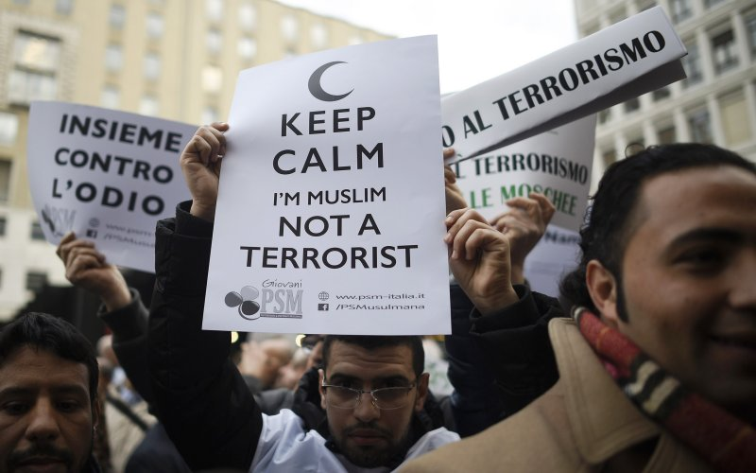
Because 26 Terrorists decided to kill thousands of people and called themselves ‘Islamic terrorists’. People all over the world began to show hatred towards all Muslim people.

Slide 8
When did it become okay to hate millions of innocent people for their religious beliefs because of the actions of just 26 men?

Slide 9
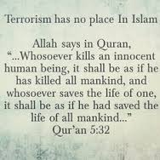
Islam is a religion that preaches and teaches about peace.

Slide 10
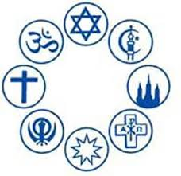
Sectarianism is when….
We treat others unfairly because of their religious beliefs.

Slide 11
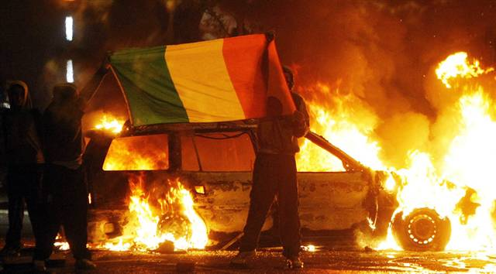
Northern Ireland has seen a lot of Sectarian behaviour.

Slide 12
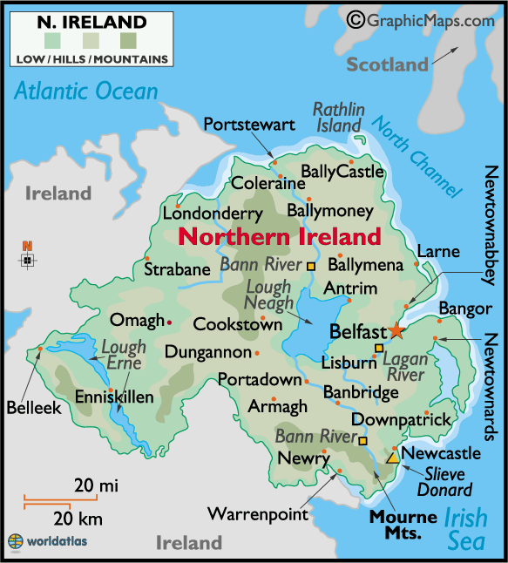
The history of Northern Ireland is full of sectarian violence.
This violence and hatred exists between two Christian denominations in Northern Ireland.
Catholics
Protestants

Slide 13
Northern Ireland is part of the United Kingdom. However, because it is part of Irish soil people who live up the North became divided. Some people were loyal to the UK and some people still thought of themselves as irish.
Some people who were loyal to the Uk were the Protestants.
Some people who were loyal to the Republic of Ireland were the Catholics.

Slide 14
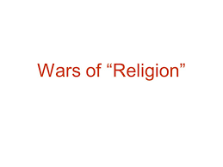
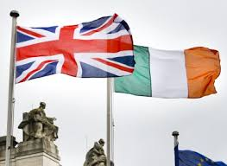
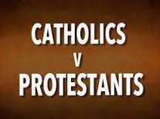
Protestant vs Catholics
Sectarian violence began in Northern Ireland. Hatred began to grow and violence caused great suffering.

Slide 15
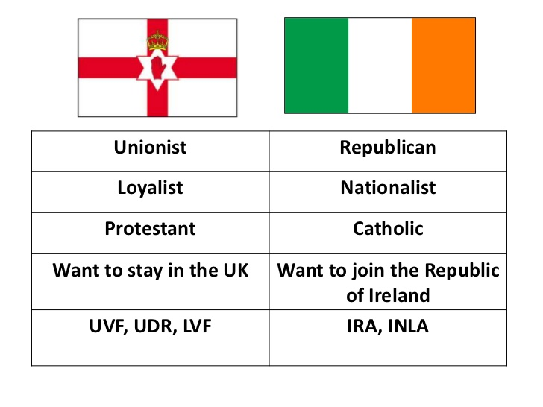

Slide 16
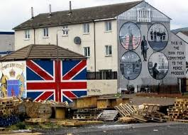
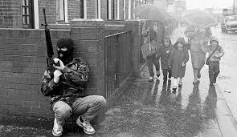
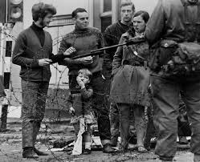
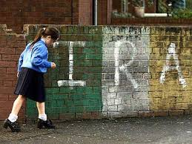
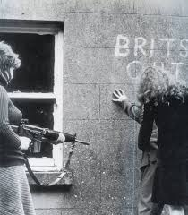
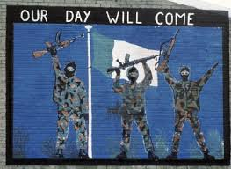

Slide 17
Religious Conflict
Sectarianism and religious conflict has occurred not only in Ireland but in other places throughout the world.

Slide 18
Group Work
Northern Ireland between Catholics and Protestants
Former Yugoslavia between Christians and Muslims
Chad between Christians and Muslims
Israel between Jews and Muslims
India between Hindus and Muslims

