Slide 1
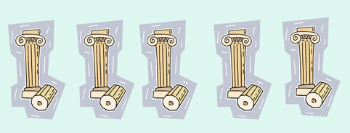
The Five Pillars of Islam

Slide 2
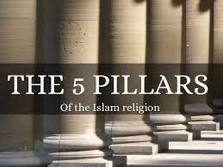
Why use Pillars?
Pillars help keep a building stable. They hold a building up and stop it from falling down.
The 5 Pillars of Islam help Muslims
keep their faith. When a Muslim person lives
their life with the support of these 5 Pillars
they believe they will have good moral and
faithful lives dedicated to Allah.

Slide 3
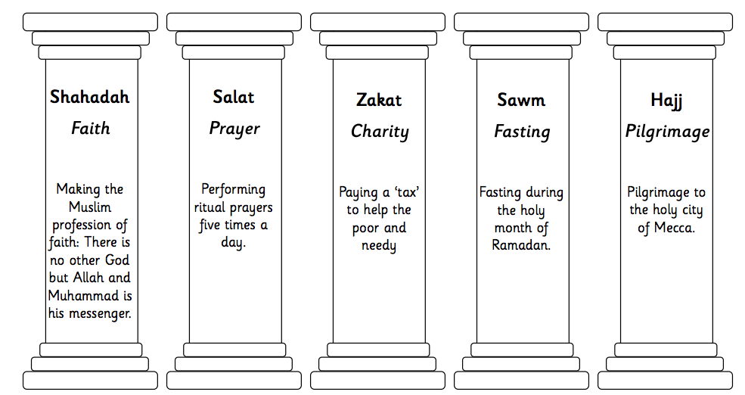
These are the 5 basic rules that Muslims follow to live a good life according to Islam

