Slide 1
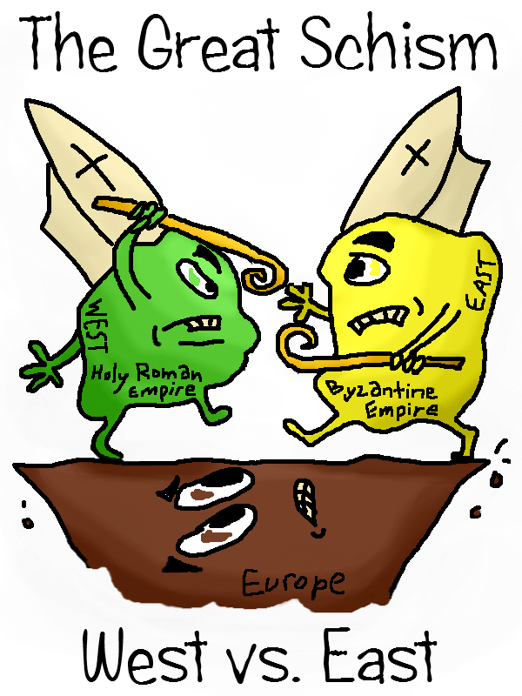
The Great Schism
A Divided Christianity

Slide 2
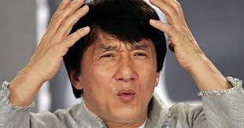
Its all a bit hazzy…...
Christianity is one very complicated world religion…
Today we hear so many people say I am Catholic, I am Orthodox or I am Protestant.
People get very confused…..am I a Catholic or am I a Christian? If I am Orthadox am I a Christian too?

Slide 3
Christianity started off as one big religion.
Christians all believe in Jesus Christ.
After Jesus died Christians (people who believed Jesus was the son of God) began to travel and settled in different places throughout Europe for over a 1000 years.

Slide 4
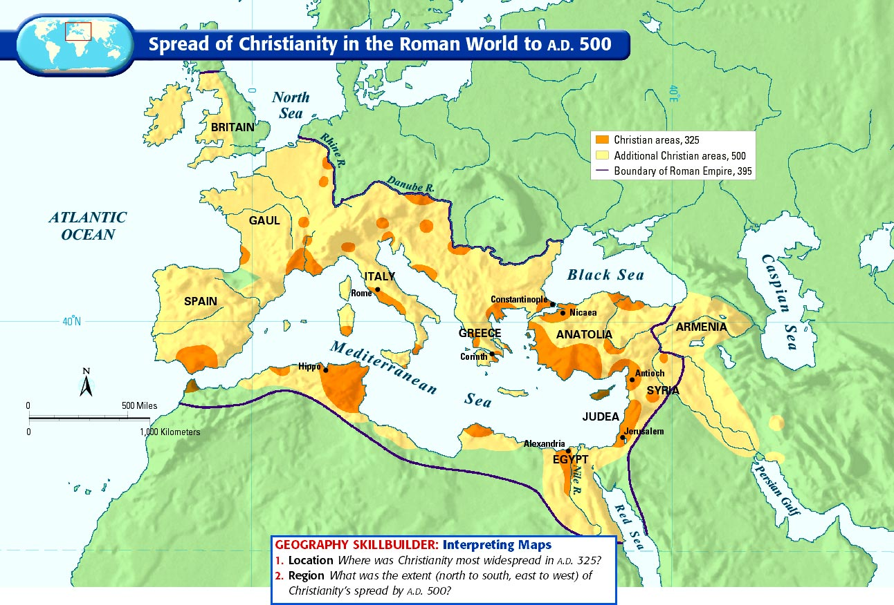

Slide 5
Bubble bubble toil and trouble….
However as Christianity started to get bigger and bigger some arguments and disagreements started to happen.
Christians could not agree on
Christian Leaders.
The way we should worship and pray.
Christian Beliefs.

Slide 6
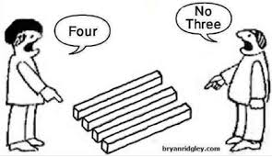

Slide 7
After hundreds of years of unity the Christian Church split

Slide 8
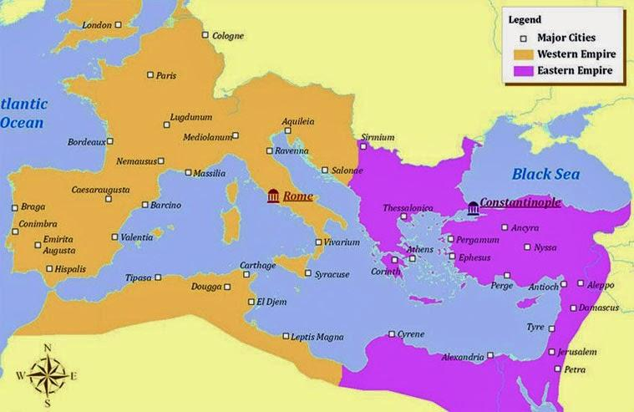

Slide 9
This split in the Christian Church is known as the Great Schism
The Christian Church was now split in two
The Roman Catholic Church in the West
The Orthodox Church in the East.

Slide 10
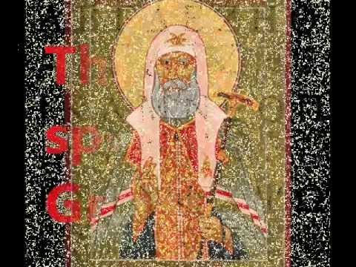
https://www.youtube.com/watch?v=wrJg4oIQ4GY

