Slide 2
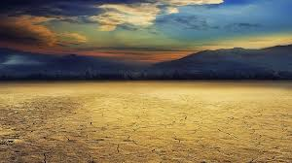
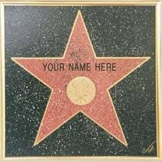
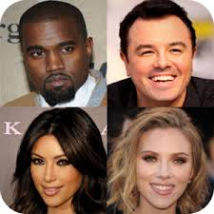
Famous Faces
Can you think of some famous people?
Can you name a famous person known to millions of people yet whose face has never been photographed, painted or drawn by anyone?

Slide 3
Founder
Muhammad is the founder of Islam.
Muslims do not allow pictures of Muhammad to be drawn or painted as a mark of respect.
When Muslims write the name Muhammad they also say “Muhammad peace be upon him” as a sign of respect.

