Slide 1
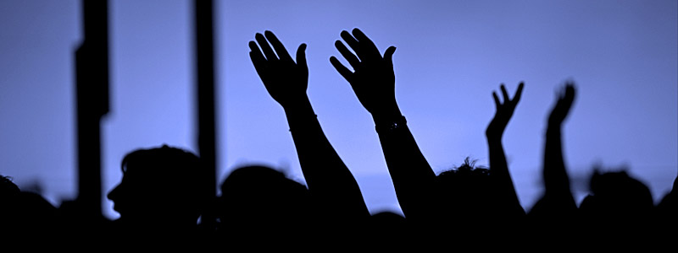
Worship

Slide 2
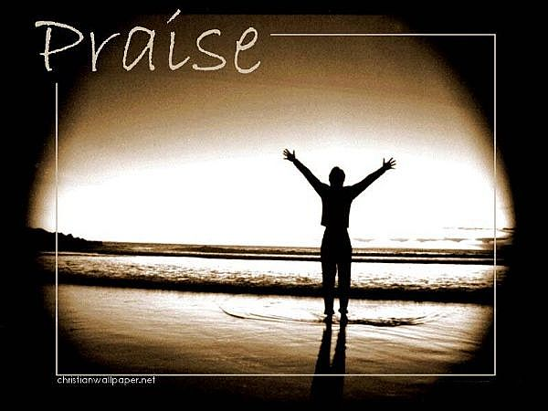
Worship
To worship means to give praise, to show love, to honour and to communicate one’s faith.
People can worship privately or publicly.

Slide 3
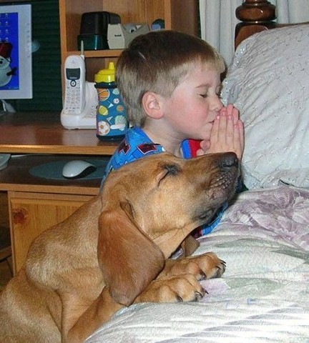
Private Worship
Prayer
Devotion

Slide 4
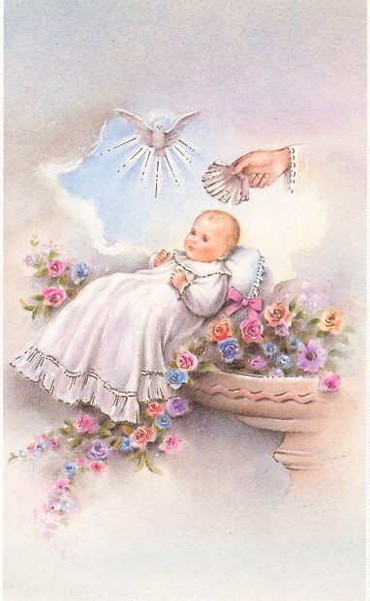
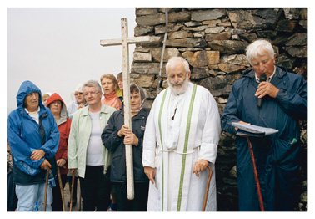
Public Prayer
Rites
Rituals
Pilgrimage

Slide 5
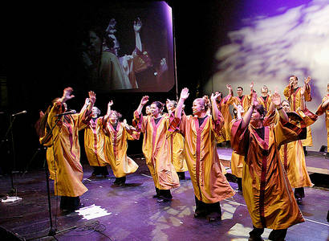
Gospel Music
Gospel Music is a way of worship. People sing and dance to praise and worship God.

Slide 6
Ritual
A series of actions carried out in a set way. Religious rituals are usually repeated regularly by the faith community to express the relationship between God and the community.
Religious ritual calls for participation and communicate with God in a meaningful way.

Slide 7
Religious Rituals
Physical Movements, actions and gestures
Connection with special events and times of significance.
Words and actions are familiar to people.
Everyone participates.

Slide 8
Rites of Passage
A rite of passage celebrates a person moving through their life.
In the Christian tradition, there are many rites of passage celebrated through the ritual of the sacraments.

Slide 9
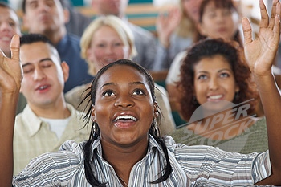
Participation
Taking an ACTIVE part in an action or activity.
Christians are called to participate in the fullness of Church.

Slide 10
The Elements of Worship
P People gather to celebrate
R Rites and Rituals take place
A Actions of significance take place
I In a sacred place
S Special events and times of significance
E Experiencing God and others in a meaningful way

Slide 11
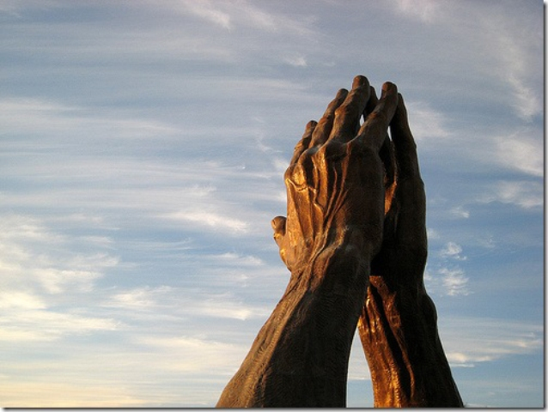
A Prayer for Everyday
Thank you for this brand new day.
Give us the wisdom to see its possibilities, the
strength to face its challenges and the grace to be
open to its promise.
Give us your heart of love to do a favour, speak a
kindness, offer a hand, soothe a hurt, celebrate a joy, share
a sorrow, and in some small way give of ourselves in love
to others in your name. Amen

