Slide 1
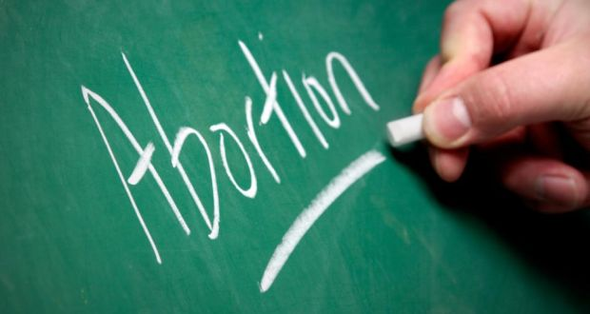
Abortion in Ireland

Slide 2
Abortion in Ireland Timeline
1983 Referendum leads to constitutional amendment recognising the right to life of the unborn child.
1986 High Court rules that women in Ireland who look for information on abortion outside the State is in breach of Constitution, as under the 1983 amendment it undermines right of the child to life.
1992 X case in which High Court ruling prevents a 14-year-old rape victim from travelling abroad for an abortion.The girl’s life is deemed to be at risk through the threat of suicide.

Slide 3
1992 Two referendums are held and further vary the Constitution by protecting the right of the mother to travel and to receive information on services abroad.
1997 C case emerges in which a teenager becomes pregnant as a result of rape and seeks an abortion in the UK.
1999 The government publishes a Green Paper outlining several options on the approach to abortion. These include constitutional and legislative changes, among them the complete ban on abortion; a restriction in the application of the X case in further cases, and legislation to regulate abortion in respect of the X case.

Slide 4
2000 An all-party Oireachtas committee publishes a paper following talks, which fails to gain a consensus .
2002 A referendum for an amendment aimed at setting aside the threat of suicide as grounds for a legal abortion is narrowly defeated.
2010 After three women take a case against Ireland, the European Court of Human Rights rules the State has failed to provide clarity on the legal availability of abortion in circumstances where the mother’s life is at risk.

Slide 5
October 2012 Savita Halappanavar dies in Galway University Hospital a week after she was admitted while pregnant. Her husband says she repeatedly asked for her pregnancy to be terminated but this was refused because there was a foetal heartbeat.
November 2012 Expert group reports to Minister for Health James Reillyon options for implementing European Court of Human Rights judgment.

Slide 6
December 2012 Government decides the implementation of this judgment by way of legislation along with regulations offers the most appropriate method for dealing with the issue.
January, 2013 The Oireachtas Health Committee begins public hearings on the implementation of the Government decision following the expert group report.
July 2013 President Michael D Higgins signs the Protection of Life During Pregnancy Bill into law.

Slide 7
June 2015 The UN Committee on Economic, Social and Cultural Rights said it was concerned at Ireland’s “highly restrictive legislation on abortion” and calls for a referendum to repeal Article 40.3.3 of the Constitution.
June 2015 The Department of Health confirms 26 terminations were carried out under the Protection of Life during Pregnancy Act in 2014.

Slide 8
June 2016 The UN finds that Amanda Mellet, who had been carrying a foetus with a fatal abnormality, to have been subjected to discrimination and cruel, inhuman or degrading treatment due to Ireland’ s abortion ban. It calls for the strict prohibition to be reversed.
July 2016 Terms of reference are outlined for a citizens’ assembly to begin examining the Eighth amendment.

Slide 9
