Slide 1
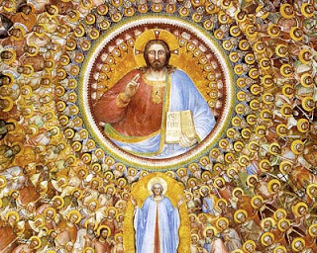
Leadership in the Catholic Church

Slide 2
Think of all the leaders in your school…..
The Principal
Vice Principal
Year Heads
Form Tutor
Teacher
Pupils

Slide 3
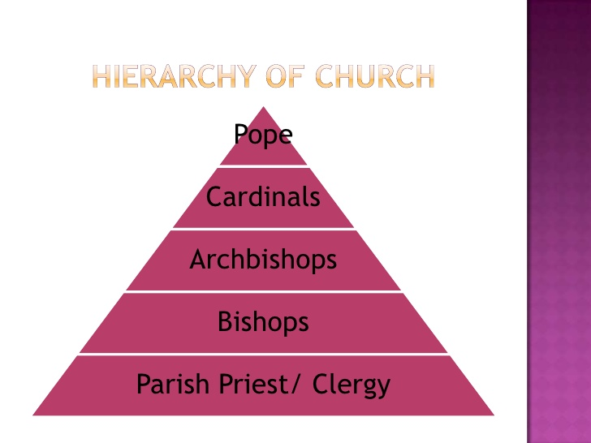
The Catholic Church has leaders too….

Slide 4
School
Catholic Church
The Principal
Vice Principal
Year Heads
Form Tutor
Teacher
Pupils
The Pope
Cardinals
Archbishop
Bishop
Priest
Lay People/Clergy

Slide 5
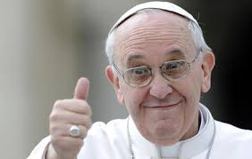
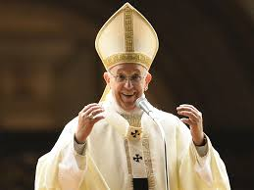
The Pope is the leader of the Catholic Church.
He is elected into his job by Cardinals.
He lives in the Vatican, in Rome.

Slide 6
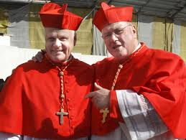
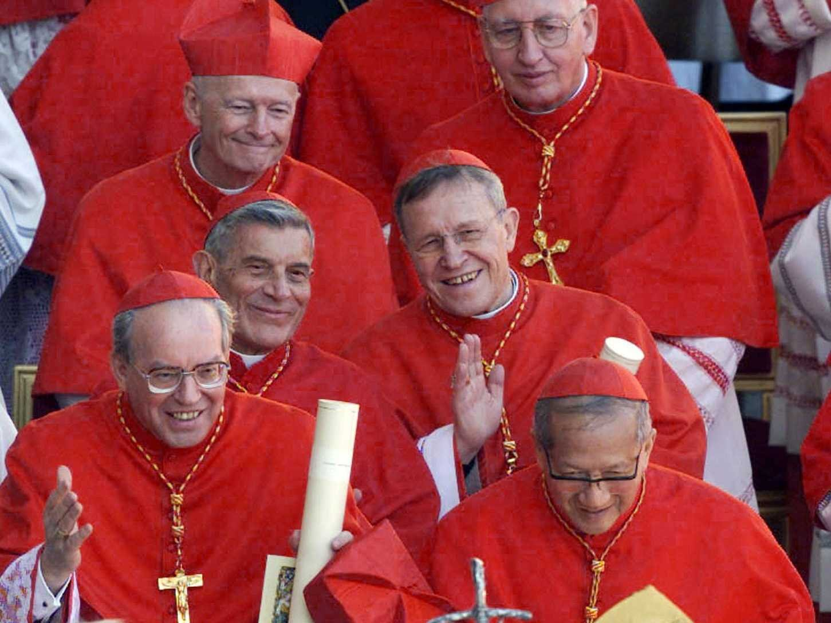
Cardinals help the Pope. They give him advice when he needs someone to talk to about important issues.
When a pope dies they get to elect a new pope.
Cardinals also look after Bishops throughout the world and make sure they are doing a good job.

Slide 7
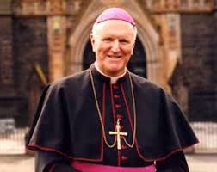
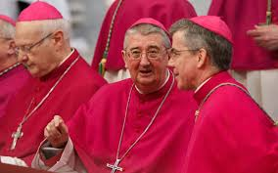
An Archbishop is next in line to a Cardinal.
They look after an area with lots of parish churches in a country. This area is called a Diocese.
For example: Dublin has an Archbishop. His name is Archbishop Diarmuid Martin.
A bishop is very similar to an archbishop they just look after a smaller area.

Slide 8
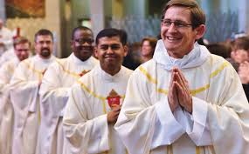
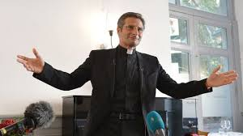
A priest is very like a teacher. It is their job to teach the people in their parish about Jesus.
A priest looks after a Church in a parish.
They say Mass for the people in their parish every day.

