Slide 1
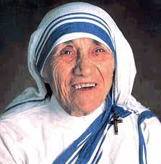
Mother Teresa
Discover why Mother Teresa is an important Christian figure

Slide 2
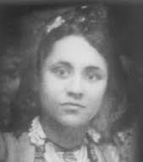
•Mother Teresa was born in Skopje part of the modern-day country of Macedonia
•She was originally called Agnes Bojaxhiu
•At the age of 18 she joined a convent of the Sisters of our Lady Loretto in Ireland where she changed her name to Mother Teresa

Slide 3
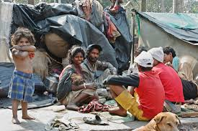
•She moved to Calcutta in India and taught at an all girls school whilst she was part of the Loreto Entally convent.
•While she was there she was horrified by the sight of so many sick and dying people on the streets.
•She knew that it was wrong and she was determined to do something about it.

Slide 4
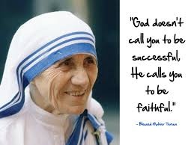
In 1946 she was travelling to Darjeeling by train “when I heard the voice of God… I was sure it was God’s voice. I was certain he was calling me”
His message was clear and she decided to leave the convent and help the poor by living among them in the slums.

Slide 5
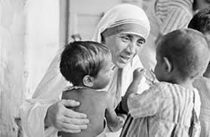
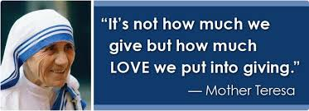
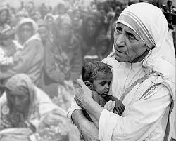
On December 20th 1948, Sister Teresa went out for the first time by herself to work in the slums of Calcutta. Calcutta is one of the world's most crowded cities. Many people had no homes. Many had only rags to wear, hunger and disease were everywhere. There were constant disgusting smells of rotting garbage and sickness. Old or sick people were left on the streets to die, eaten by rats and insects. Unwanted babies were thrown out onto rubbish heaps.

Slide 6
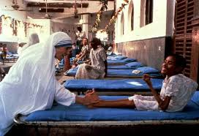
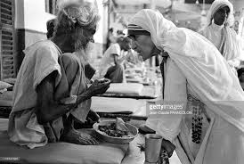
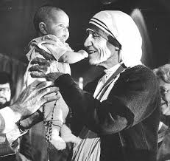
Mother Teresa set up hospices for the dying, homes for the orphans and care centres for people who were suffering from AIDS and leprosy.
She said her mission was to:
‘care for the hungry, the naked, the homeless, the crippled, the blind, the lepers, all those people who feel unwanted, unloved, uncared for throughout society. People who have become a burden to the society and are shunned by everyone.’

Slide 7
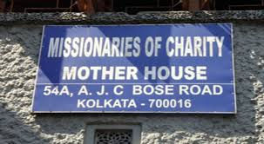
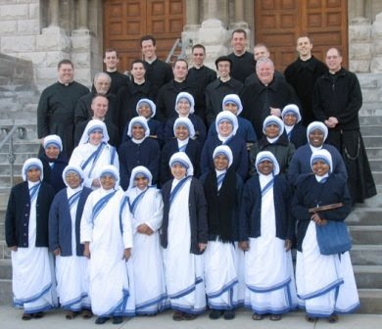
Mother Teresa set up a new Religious Order called
The Missionaries of Charity.

Slide 8
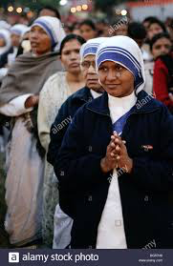
The Missionaries of Charity is a Catholic religious order. It works among the poorest of the poor all around the world. A religious order is a community of faith.

Slide 9
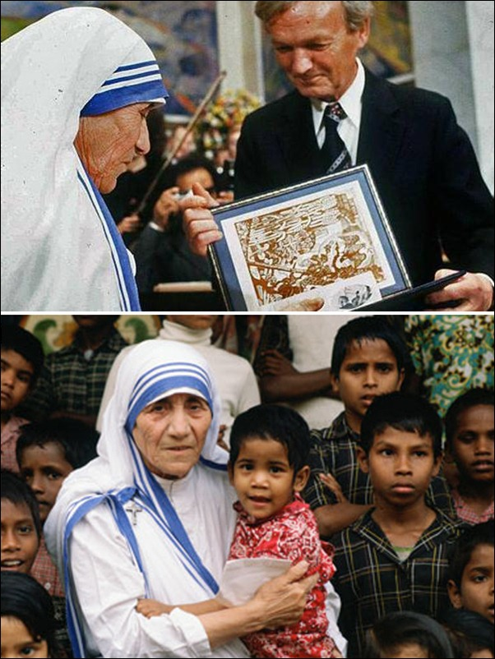
She won the Nobel Peace prize
in 1979.
She dedicated her entire life to
helping others until she died in
1997.

Slide 10
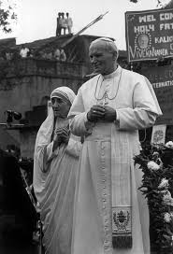
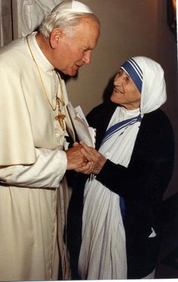
Pope John Paul II said
‘Mother Teresa’s smile, words and deeds, Jesus walked the streets of the world as the Good Samaritan.’
The Church on September 6th 2016 will Canonise her.

Slide 11
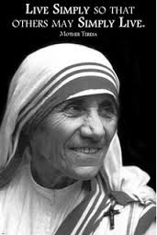
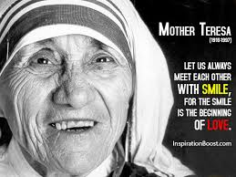
Slum: A very run down, poor place.
Hospice: A place of care and support of people who are dying.
Leprosy: A serious illness which can cause the sufferer great pain and loss of limbs.
Burden: A hardship or heavy load or worry.
To shun: To ignore or reject.
Canonise: To make a saint.

