Slide 1
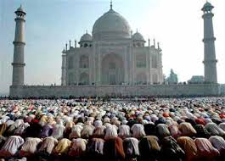
Prayer
Salah (Salat)
The 2nd Pilar of Islam

Slide 2
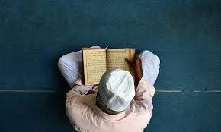
Why Pray?
The Qur’an says that Muslims must pray 5 times a day.
Praying gives Muslims special times during the day when they can be alone with Allah.
Prayer is about keeping in touch with Allah.
It is a way to communicate with Allah.

Slide 3
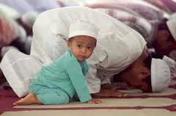
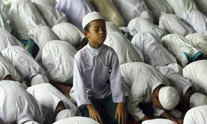
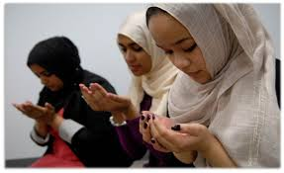
Salah (Salat)
This is a form of prayer.
Muslims pray 5 times a day: Morning, midday, afternoon, sunset and before going to bed.
Anyone over 12 years of age must pray at these times throughout the day.
Salah is a ritual that can be done alone, with people or in a Mosque.

Slide 4
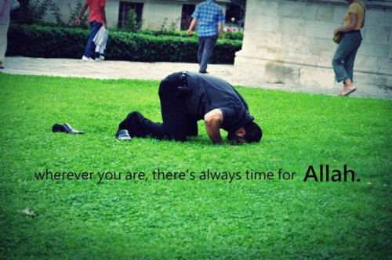
Video
Link:
Muslim Prayer

