Slide 1
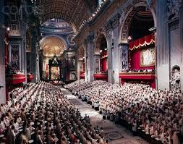
Second Vatican Council
(Vatican II)

Slide 2
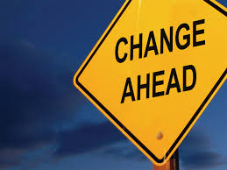
Time to Change….
Back in the 1960’s the Catholic Church began to get worried that people were turning away from their faith.
So, the Catholic Church decided they needed to change and to become more modern.

Slide 3
They also wanted to encourage Christians to work for Justice and peace within the world.

Slide 4
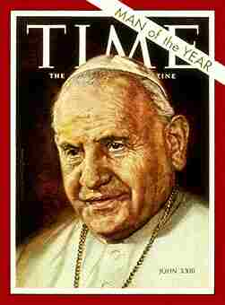
A Visionary….
This they thought would help people have a sense of belonging within the Church.
So, in 1962 Pope John XXIII (23rd) decided to form a Council to help reform the Church.

Slide 5
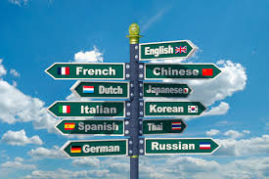
Language
Before Vatican II Mass was said in Latin, meaning if you attended mass you did not understand what the priests were saying.
After Vatican II Mass was said in the language of the people. This is called the Vernacular.

Slide 6
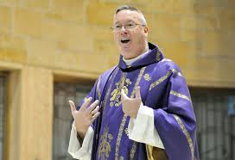
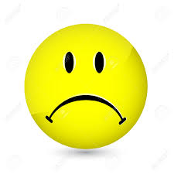
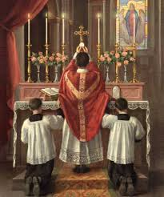
The Priest
Before Vatican II the priest stood with his back to the congregation.
After Vatican II the priest stood facing the congregation.

Slide 7
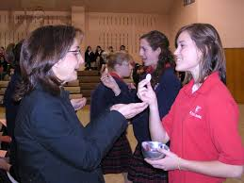
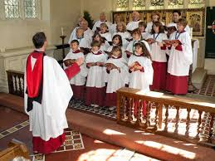
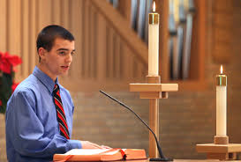
The People
The people (lay people) were encouraged to become more involved at Mass by singing, giving out the Eucharist and reading.

Slide 8
Key Words
Council: a group of people brought together to make decisions and bring about change.
Reform: To change.
Lay Person: a person who is not part of the clergy.
Vernacular: language spoken by ordinary people of a country or area.

