Slide 1
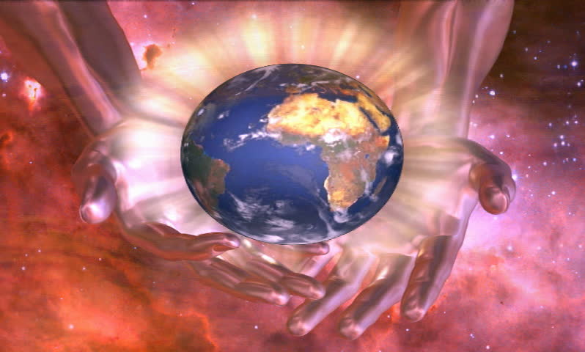
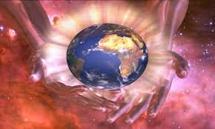
Stewardship
Care for the Earth

Slide 2
What will we learn?
We will be able to show how religious moral vision can influence decisions on the environment.

Slide 3
Respect: to have a high regard for someone or something, and to treat each others with great care.
Stewardship: in religious terms this means the way people care for the Earth on behalf of God (because God created the world)

Slide 4
What is a Steward?
A steward is like a caretaker who looks after someone else’s property. Stewardship in a religious sense is caring for the Earth on behalf of God.
People do not own the Earth, we are its caretakers.

Slide 5
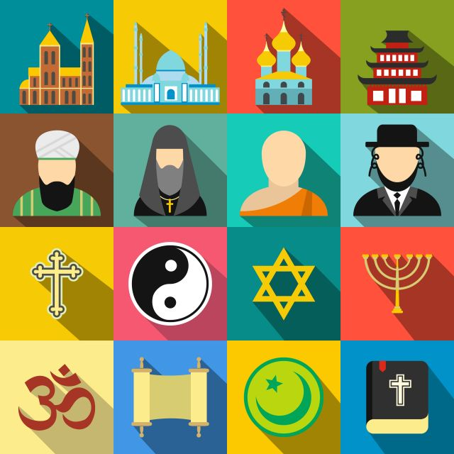
World Religions
In 1995 leaders of major world religions met in Japan to raise awareness about the need to care for and look after the environment.
The agreed that:
It is our duty to care for the Earth.
The cause of environmental problems is greed.

Slide 6
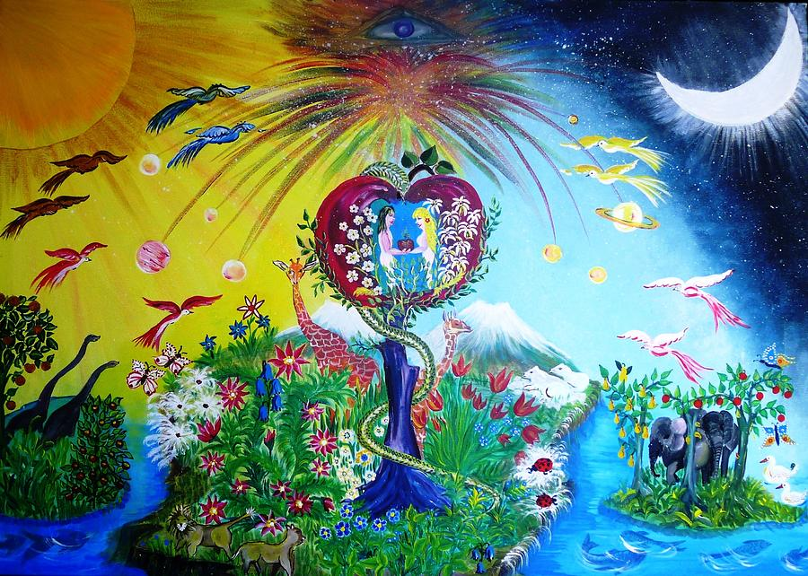
The Story of Creation
The Bible Teaches that:
God created the earth
God put humans on the earth to look after it.

Slide 7
Jews and Christians share the same story of creation. This story can be found in chapter one of the Bible: Genesis

Slide 9
Called to protect
The idea of stewardship came from Genesis when God told Adam and Eve to look after and protect the Garden of Eden.
The Earth is on loan to us, it does not belong to us, it is a gift from God.

Slide 10
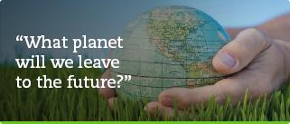
Christians believes it is our duty to look after this gift, our home, planet Earth.

