Slide 2
500 years after the Great Schism…..Christianity divided AGAIN!!

Slide 3
This split is called the reformation because reform means to change.

Slide 4
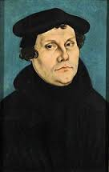
A German Monk called Martin Luther protested because he disagreed with all the corruption in the Catholic Church.

Slide 6
Why was Martin Luther so angry at the Catholic Church?
He hated all the power the Pope had over politics.
He did not agree with Catholic priests taking money off people and telling them this money would help them get to heaven.
He believed the Catholic Church should not indulge and be so wealthy.

Slide 7
So Martin nailed a list to the doors of a Catholic Church.
This list stated everything that should be changed within the Catholic Church.

Slide 8
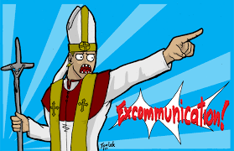
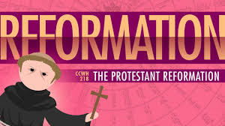
Luther was kicked out of the Catholic Church

Slide 9
As a result a new Christian denomination was formed. People who followed Luther became known as Protestants.
These New churches set up at this time were called Protestant Churches because the people who formed them had protested against the Catholic Church

Slide 10
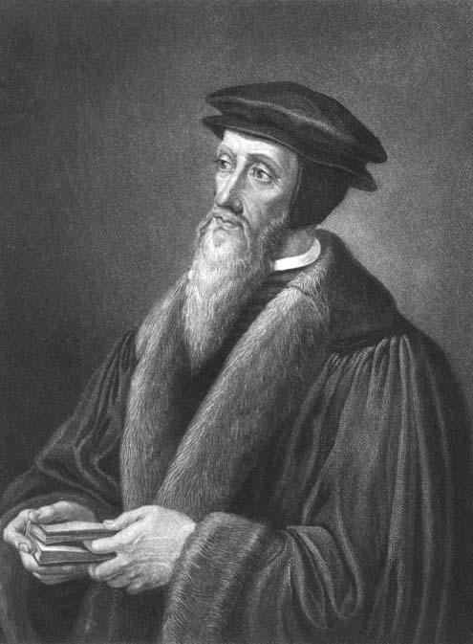
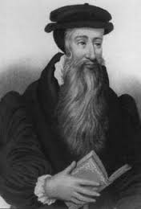
Call for Change
Other reformers began to call for more change in the Catholic Church. Christianity in the west of Europe saw a big change. It divided again between:
People who wanted reform and change.
People who stayed with the Catholic Church.

Slide 11
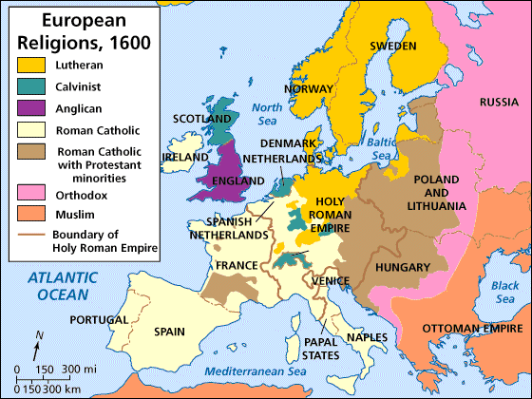

Slide 12
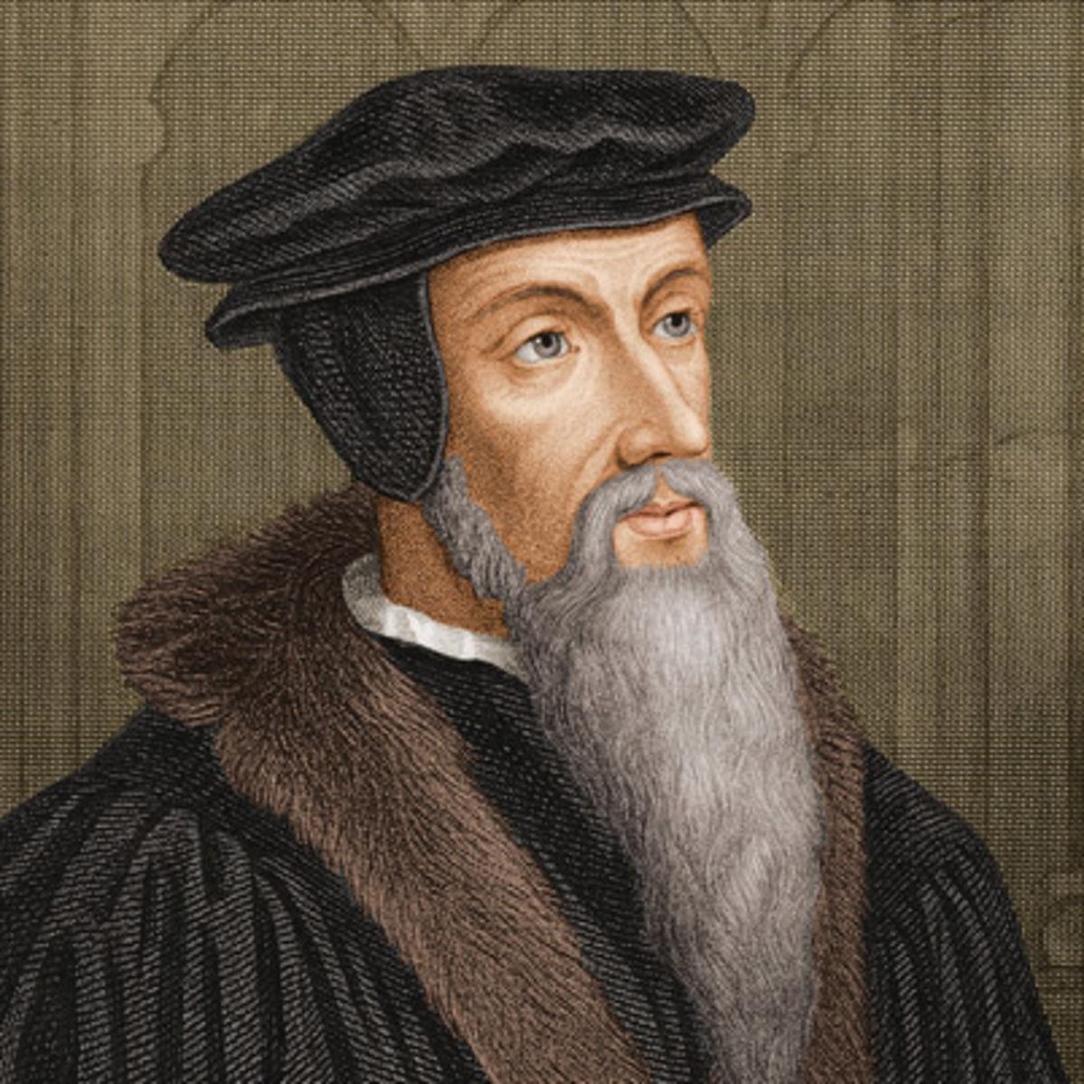
Calvinism
John Calvin was a reformer and he began a new form of Christianity called Calvinism

Slide 13
Presbyterian
John Knox was another reformer who called for change. He set up the Presbyterian Church in Scotland.

Slide 14
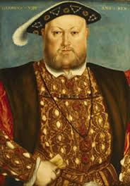
Anglican
Church of England
King Henry the 8th broke away from the Catholic Church when he was denied a divorce. He decided to set up his own Church. He was the head of the Church of England.

